Slide 1
You can visualize your thoughts, feelings and attitudes towards human-robot collaboration using a method called Cognitive-Affective Mapping (CAMing).
Please scroll down and read the instruction manual attentively and completely.
We will show you how CAMing works using a simple example.

Slide 2
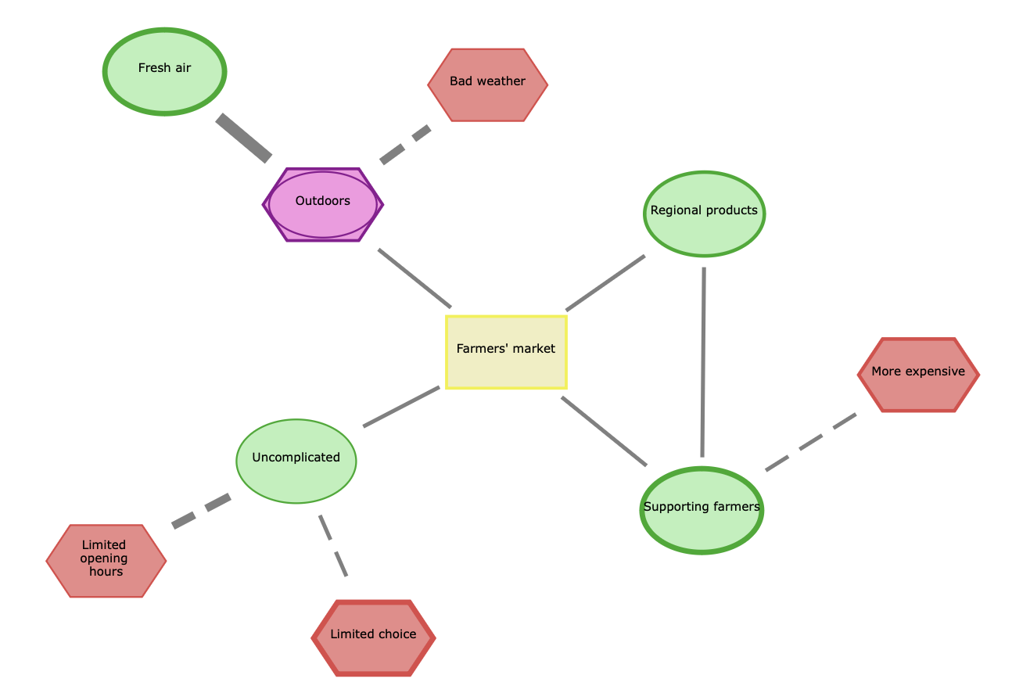
Example: Shopping at the farmers’ market
In this fictitious example, Julia is asked to draw a cognitive-affective map (CAM) on the topic of 'shopping at the farmers' market'. Julia considers which thoughts and feelings come to her mind on this topic.
Using the CAM method, she can visualize her thoughts and feelings as a network consisting of nodes and connecting lines. In the end, her CAM could look like this, for example:

Slide 3
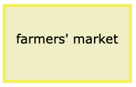
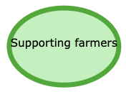
On the other hand, it comes to her mind that shopping at the farmers’ market is more expensive than in the supermarket, so she places a red hexagon with a thin red boarder next to the first node.
With a violet node she indicates that she has ambivalent feelings about the farmers’ market happening outdoors. It is nice when the weather is good, but she doesn’t like it in case of bad weather.
In this way, she goes on to create a network of cognitive concepts and affective ratings. The solid and dashed connection lines indicate whether two concepts support or inhibit each other.
Drawing a CAM is very easy. With Julia as an example, we explain how it works…
The topic of the CAM is depicted as a yellow, affectively neutral rectangle in the middle of the canvas.
Julia thinks that she supports the farmers and associates positive feelings with it, so she places a green oval with a thick green boarder on the canvas.

Slide 4


To add a concept, she simply clicks on a free space on the canvas.
A yellow box will appear.
By clicking again on a free space on the white background, Julia can add as many concepts as come to her mind.

Slide 5
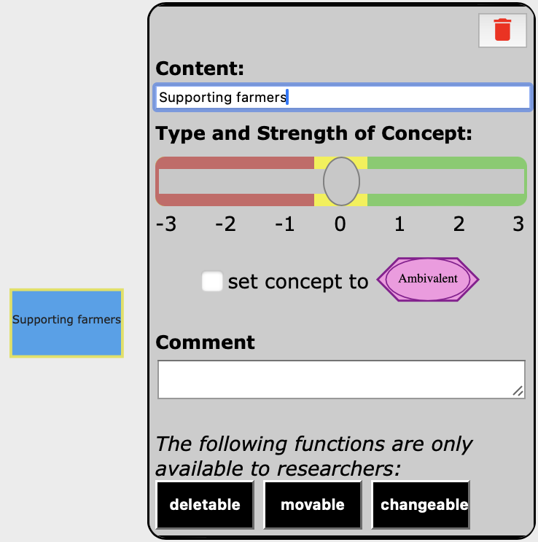
To edit the concept, Julia double-clicks on the rectangle. A control panel appears.
Here she can enter her thought using 1-3 words.
She can also indicate whether she associates her thought/concept with neutral, positive, negative or ambivalent feelings.
Moreover, she can explain her concept in more detail by providing a comment.

Slide 6




Attaching feelings to a concept:
The way Julia feels about a concept is represented by a shape and color code.
Her feelings can be neutral, positive, negative or ambivalent.
A concept is neutral if she associates neither positive nor negative feelings with it.
On the other hand, a concept that she associates with both positive and negative feelings is ambivalent.
neutral
negative
positive
ambivalent

Slide 7
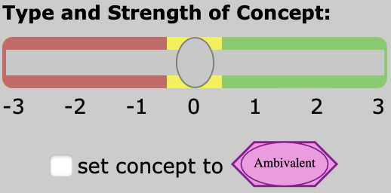
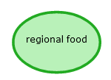
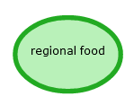




Julia adds positive or negative feelings to the concept by moving the slider either to the right (positive) or left (negative).
Very negative
Intermediate negative
Slightly negative
Slightly positive
Intermediate
positive
Very positive
The slider offers three levels of emotional strength.
The thicker the border, the stronger the feeling.

Slide 8
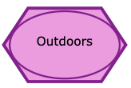
Julia is ambivalent about the fact that the farmers' market is taking place outdoors. Ambivalent means that Julia has mixed feelings, i.e. both positive and negative.
To indicate ambivalence, Julia clicks the box under the slider. Ambivalences are shown as superimposed violet ovals and hexagons.
✓

Slide 9

Below you can see once more all colors, shapes and their meanings.
The thicker the border (for green and red), the more intense the feeling.
neutral
ambivalent
negative
positive

Slide 10
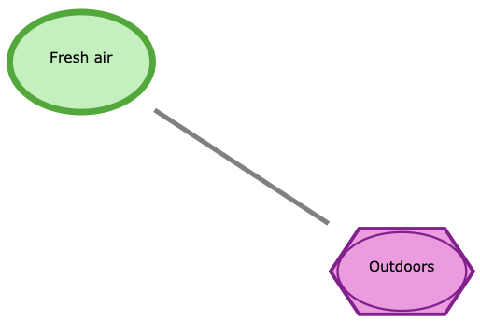
Connecting concepts with each other
Julia identifies two concepts that she wants to connect and single-clicks on them one after the other. A connecting line appears.

Slide 11
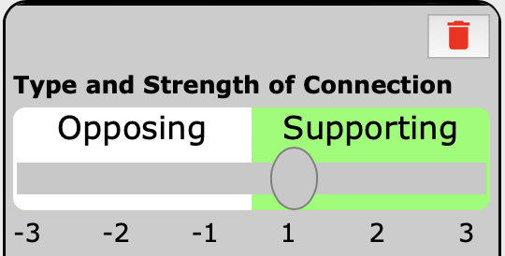
Julia double-clicks on a connecting line.
A control panel appears. She can now drag the slider to the right for a supporting connection (solid line) or to the left for an opposing connection (dashed line).
A solid connection indicates that two concepts agree or support one another.
A dashed connection indicates that two concepts conflict or oppose one another.

Slide 12
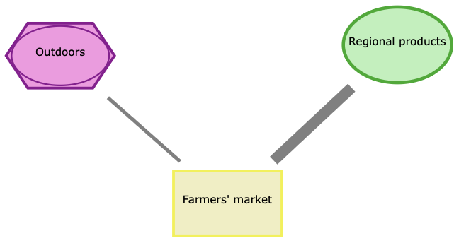
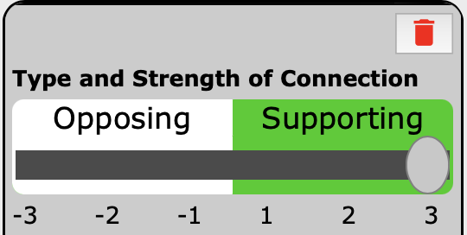
The thickness of the lines indicates that Julia sees a strong connection between regional products and the farmers' market. The connection to ’Outdoors’ is weaker.
For the connection to ’Regional products’, she moves the slider to the very right.

Slide 13
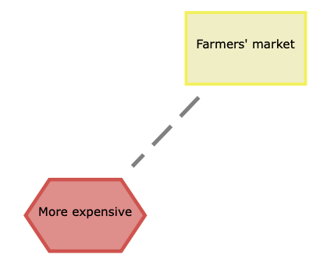
The fact that the products are generally more expensive than in the supermarket tends to speak against shopping at the farmers' market. Julia expresses this with a dashed line.
This means: The more expensive the food, the less likely Julia is to go shopping at the farmers’ market.

Slide 14
Here you can see again the types of connecting lines:
Concepts oppose each other
Concepts support each other
Example:
If the weather is bad, Julia doesn't go to the farmers’ market.
Or: If bad weather, then no farmers’ market
Example:
When the weather is good, Julia goes to the farmers’ market.
Or: If good weather, then farmers’ market

Slide 15
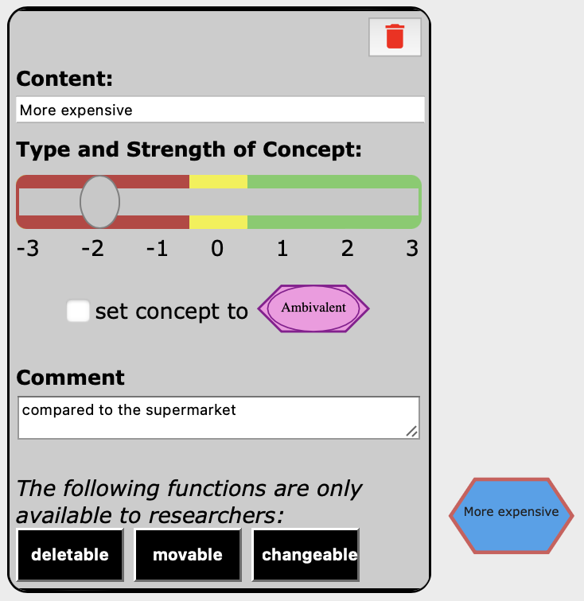
Adding a comment
As Julia can only type up to three words into the ’Content’ textbox, she can additionally comment on each concept in her map by
double-clicking on it and then typing into the ‘Comment’ textbox.

Slide 16
Deleting concepts or connections
Concepts and connections can be deleted by clicking on the red trashcan symbol in the respective control panel.

Slide 17
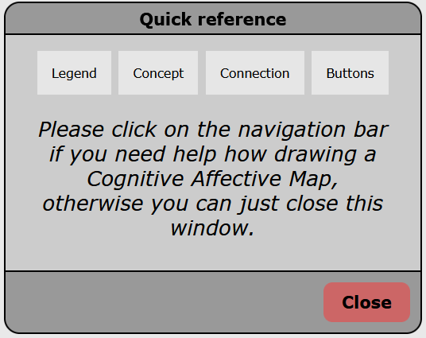
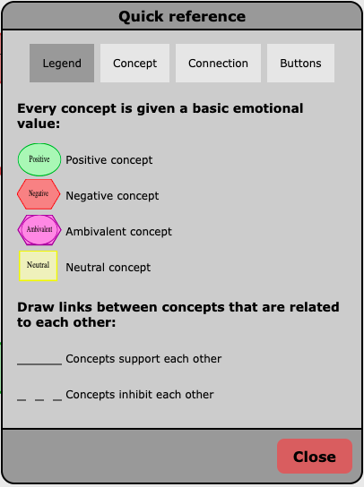
If Julia needs help drawing her CAM, she can click on the green question mark symbol.
A menu with quick references will appear. There she can navigate by clicking on the topics she needs help for.

Slide 18
IMPORTANT: Saving the CAM
When Julia has finished her Cognitive-Affective Map, she clicks on the disk symbol to save it.
Note: She can only save her map, if she has connected all concepts.
The CAM can have as many concepts as one likes – your task will be to draw a CAM with at least 12 concepts.

